Slide 2
Panel
Andrew Heaney
Associate Manager | Public Consulting Group
Chris Smith
Enterprise Architect | Public Consulting Group
Michael Van Popering
Technology Consultant | Public Consulting Group
Notes:
Introductions

Slide 3
Health Information Exchange
Project Management Office (PMO) and Health Information Exchange (HIE) Interoperability Primer
US Virgin Islands
+

Slide 4
Agenda
Overview of PCG’s Role
PMO/HIE Starting Point
Progress
Challenges
Aim & Impact
Opportunity for HIE
Health Data Ecosystem
Vision for the HIE
PMO/HIE Timeline
Next Steps

Slide 5
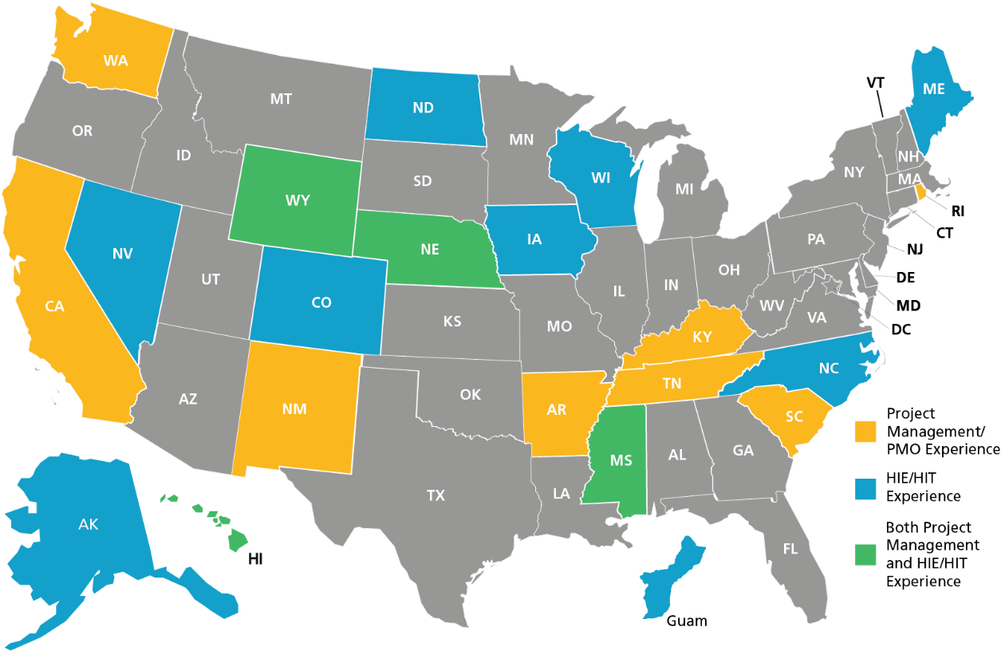
Experience Makes the Difference

Slide 6
The PCG Approach – How It Works for USVI

Slide 7
Architecting the HIE
Current State Assessment and Future Vision
Gap Analysis
Roadmap and Implementation Plan
Technical Architecture and Infrastructure
Funding
Technology

Slide 8
Stakeholder/Provider Outreach and Organizational Change Management
EVALUATE
Understand the USVI landscape through source material review and environmental scan
ENGAGE
Build internal and external coalitions that facilitate awareness and engagement
ENABLE
Equip USVI stakeholders with the ability to succeed through detailed training
EMPOWER
Provide opportunities for USVI stakeholders to ownership through workshops
EVOLVE
Partner with USVI to develop an approach for continuous improvement

Slide 9
Accomplishments So Far
PCG is operating PMO leveraging SharePoint sites and task management processes | Examining different governance options, to be covered in a break-out session | Submitted the Planning – Advance Planning Document (PAPD) to CMS in May for initial funding | Submitted Implementation – Advanced Planning Document (IAPD) to CMS in July for extended funding

Slide 10
Challenges
Securing federal funding to reduce burden on the USVI
PCG is exploring a variety of options from different agencies
Staffing the HIE with on-island resources
Sufficient experienced personnel may not exist in the territory, may have to consider external staffing
Ensuring the solution is accessible to all stakeholders
Engaging with all relevant stakeholders in each stage of the project

Slide 11
Interoperability

Slide 12
The Aim
Interoperability seeks to empower providers, patients, and policy makers with timely, contextualized information from traditionally disparate data sources.
Breaking down information silos is a crucial first step in better understanding the state of healthcare in the US Virgin Islands.
Can help to identify opportunities, address gaps, and improve health outcomes in the community, through data-driven interventions.

Slide 13
Opportunity for Health Information Exchange
Trusted exchange
Brings the territory in compliance with Office of National Coordinator (ONC) and Centers for Medicare & Medicaid Services (CMS) guidance
Affords piece of mind to health care providers and patients that health data is being shared in private and secure manner
Community alignment
Hospitals and FQHCs have identified and engagement has commenced
HIE can help to centralize these efforts, breakdown silos
Federal cost sharing
CMS can offer funding at a high match rate
Additional grant funding available to support peripheral infrastructure

Slide 14
HIE Data &
Ecosystem
Hospitals & Health Systems
Physician Offices & Groups
Payers
Medicaid
Laboratories
Public Health
Patients
Post Acute Care& Home Health
Community Services
Provider Notes
Laboratory Results
Diagnoses
Consent
Claims
Messaging
Prescriptions
Admit Discharge Transfer (ADT) Alerts
Health Information Exchange
Quality Measures
Appointments
Social Determinants
Referrals
Directories
Prior Authorizations

Slide 15
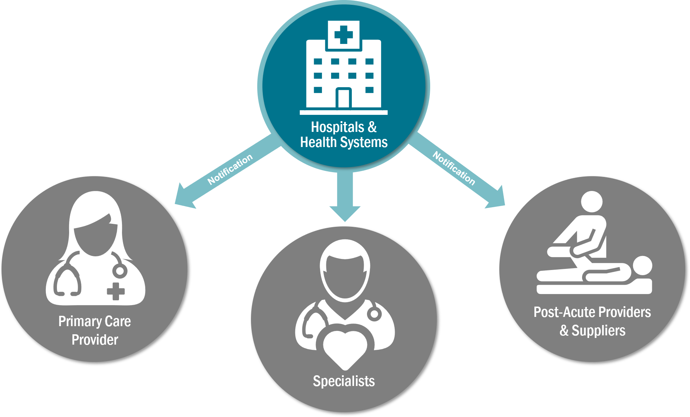
For Providers
Phase 1 HIE Benefits
Notifications when your patients encounter the healthcare system
Access to electronic laboratory results from participating laboratories
Regulatory Drivers
Required to support ADT messaging
June 30, 2021
Required to utilize certified EHR with USCDI and FHIR
December 31, 2022
Notes:
- ADT
- HL7
- USCDI

Slide 16
Next Steps
Stakeholder Alignment
Meetings with representatives of participant health care organizations and government to align on goals and governance
Funding Allocation
Submittal of IAPD for federal funding through Medicaid
Collaboration with Department of Health on Public Health Infrastructure Grant
Technology Procurement
Requirements gathering for approved use cases
Vendor evaluation and contracting

Slide 17
The Path Forward

Slide 18
Project Timeline
Federal funding was secured to support the planning and gathering of information for development of the HIE procurement. Procurement and related activities are expected to occur between October 2022 and May 2023
Development, Design, and Implementation project to take place between June 2023 and September 2026
2022 | 2023 | 2024 | 2025 | 2026

Slide 19
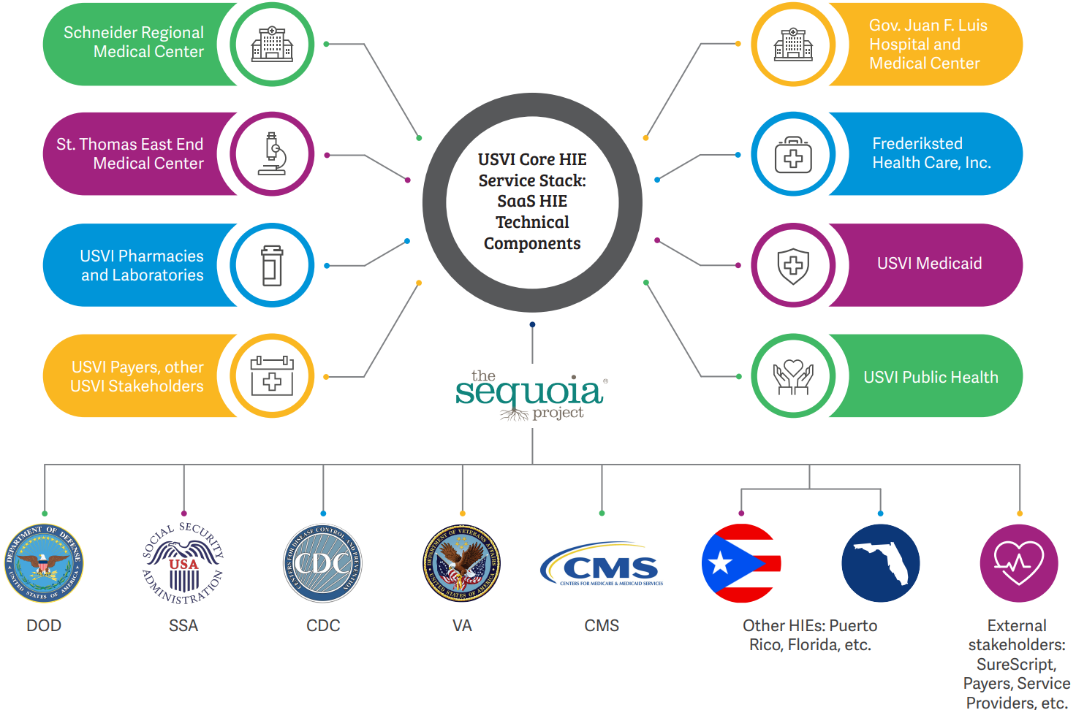
Vision:
USVI Health Information Exchange

Slide 20
USVI Core HIE Service Stack

Slide 21
PMO/HIE Next Steps
PCG will identify further funding opportunities and assist the USVI in applying for them

